Slide 1
Reinforcement Trade
An Experiment on Apply Deep Reinforcement Learning to train Equity Trading Agent
By Zhongheng Li
For CSCI E-89 Section 2 (25792) – Deep Learning

Slide 2
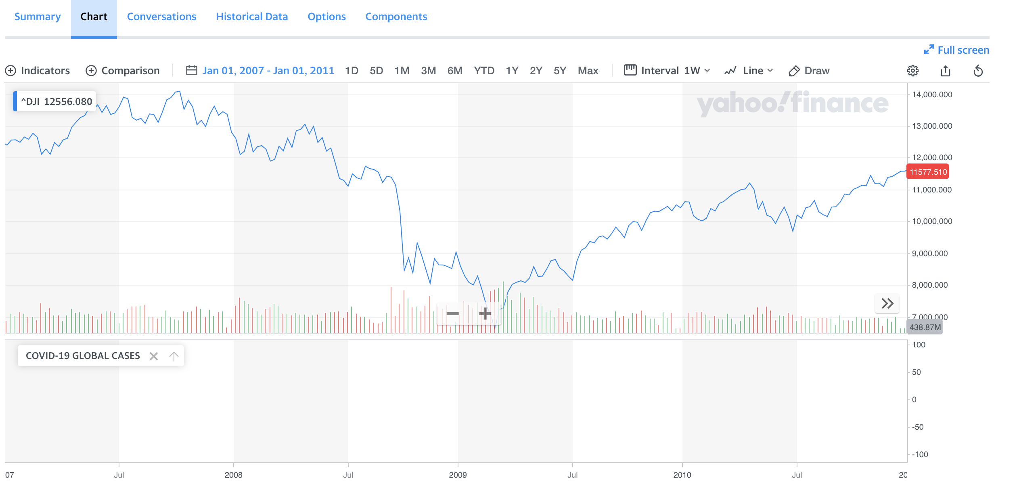
Problem Statement
In late 2008, the stock market crashed due to the Subprime Mortgage Crisis
The machine learning technologies were not as advanced, and not as accessible as now in 2020

Slide 3
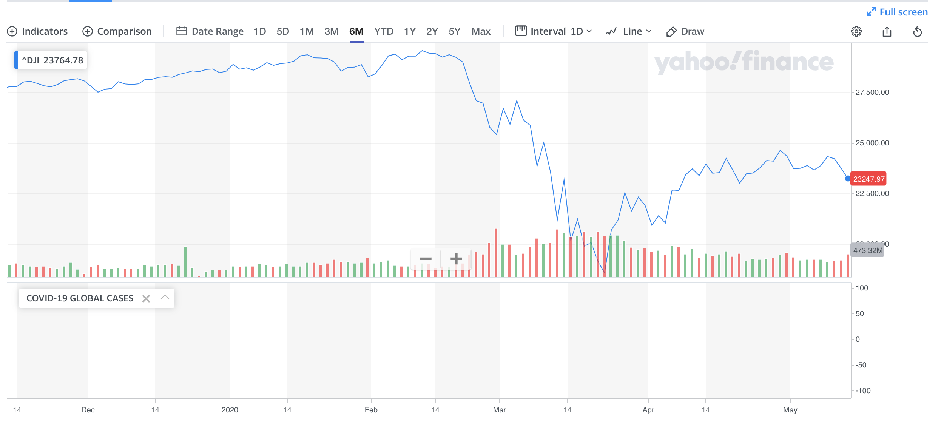
Problem Statement
As in 2020, humanity is facing an unprecedented crisis that due to the COVID-19
For economy alone. We are facing a much more serious financial crisis at global scale

Slide 4
Problem Statement
As in 2020, more than a decade after the last financial crisis, with many AI breakthroughs in recent years, can we leverage machine learning to assist us to get over the on going financial gap?
Can we leverage AI agent as an assistant to help us to hop over the financial gap year(s)?
Disclaimer – this project is simply an experiment to explore the feasibilities for apply machine learning in finance. There are many fin-techs and big financial companies are already doing this sim2real approach
For example JP Morgan’s ML trading on Foreign Exchange

Slide 5
Why Reinforcement Learning?
Traditional timeseries analysis and predative approaches are deterministic and bounded by historical data
Basically turned it into a supervised learning problem
However, in the real world, there are many factors that can create too many uncertainties. It is better t o

Slide 6
The Agent Training Environment – The Gym
Utilizing a very simple Stock Market OpenAI Gym based environment that create by Adam King
https://towardsdatascience.com/visualizing-stock-trading-agents-using-matplotlib-and-gym-584c992bc6d4

Slide 7
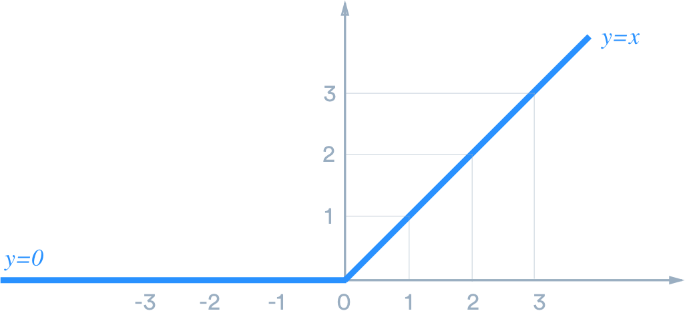
The Agent Training Enviroment – The Gym
ReLu is the activation function to determine the action.

Slide 8
Data Source
Data from Yahoo Fiance. Daily stock OHLCV data from May 1998 to May 2020 for the following 2 stocks:
Apple
Microsoft

Slide 9
Exploratory Data Analysis

Slide 10
Data Augmentation with Domain Randomization
Domain Randomization for Transferring Deep Neural Networks from Simulation to the Real World

Slide 11
Approach 1 – Semi Continuous Deep Q-Network (DQN)
Our problem is a semi continuous problem. We do have discrete actions: Buy. Sell and Hold. But we also have continuous number of shares we can buy/sell

Slide 12
Approach 1 – SC-DQN
Our problem is a semi continuous problem. We do have discrete actions: Buy. Sell and Hold. But we also have continuous number of shares we can buy/sell

Slide 13
Approach 1 – SC-DQN - Results

Slide 14
Approach 1 v2 – DQN with LSTM

Slide 15
Approach 1 v2 – DQN with LSTM - Results

Slide 16
Approach 1 v2 – DQN with LSTM Transfer Learning
Transfer learning from learning with Microsoft data to Apple data

Slide 17
Approach 2 – Actor-critic model
Try out a real continuous 2 input duel model approach

Slide 18
Approach 2 – Actor-critic model - Results

Slide 19
Future Works – Actor-critic model with LSTM and more

Slide 20
Future Works – con
Work with COVID data for penalty and rewards on training policies

Slide 21
Summary
Heavily enhanced the StockMarket Gym Env
Try out different deep RL models
Modify the code from TF1 to TF2
https://github.com/heng2j/RL-Trade

Slide 22
References
References:
https://github.com/firmai/financial-machine-learning/blob/master/README.md
https://github.com/huseinzol05/Stock-Prediction-Models#simulations
https://towardsdatascience.com/introduction-to-various-reinforcement-learning-algorithms-part-ii-trpo-ppo-87f2c5919bb9
https://towardsdatascience.com/advanced-reinforcement-learning-6d769f529eb3
BTGYM
Information trading
https://github.com/Kismuz/btgym/blob/master/examples/multi_discrete_setup_intro.ipynb
Corona Virus cases
https://github.com/nytimes/covid-19-data/blob/master/us.csv
References:
https://towardsdatascience.com/reinforcement-learning-w-keras-openai-dqns-1eed3a5338c
https://towardsdatascience.com/reinforcement-learning-w-keras-openai-actor-critic-models-f084612cfd69

